Slide 1
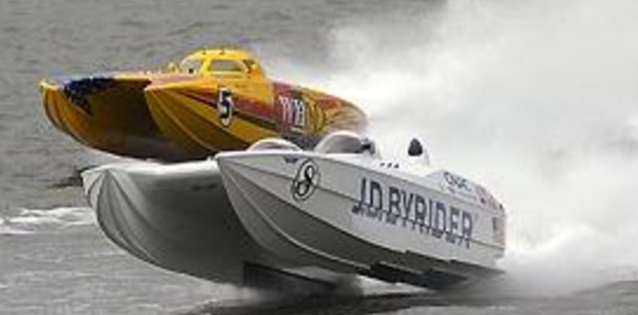
Relative Motion

Slide 2
Resolving a Vector

Slide 3
Relative Velocity-Basic Principle

Slide 4
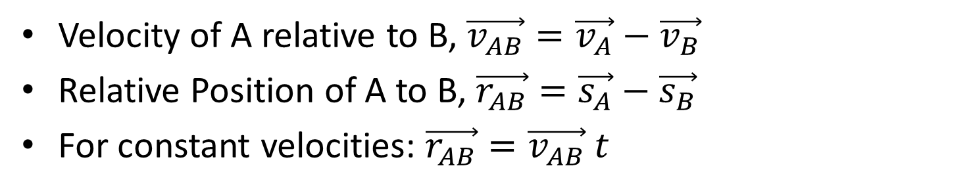
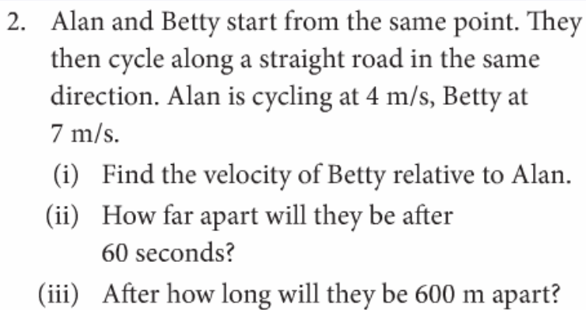
Introduction to Relative Velocity
One Dimension: Page 50 Q2. (hwk/cwk q1,3,4)

Slide 5
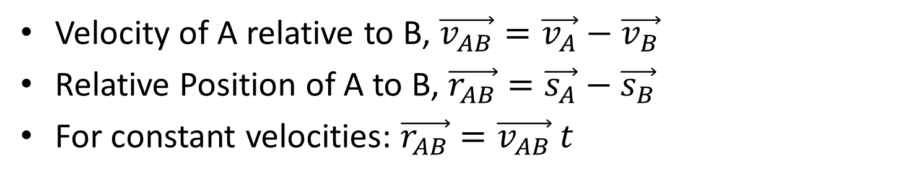
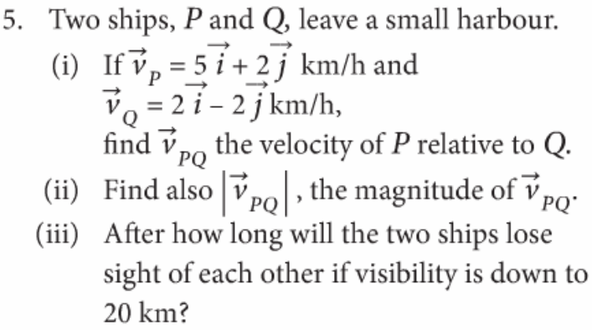
Introduction to Relative Velocity 2-Dimensions
2 dimension: Page 50 Q5. (hwk/cwk q6)

Slide 6
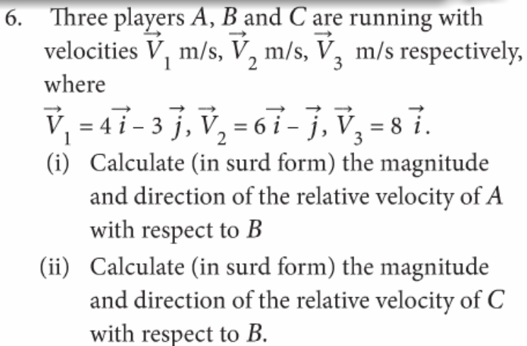
Relative Position Vectors, P50 Q7. (hwk/cwk q8)

Slide 7


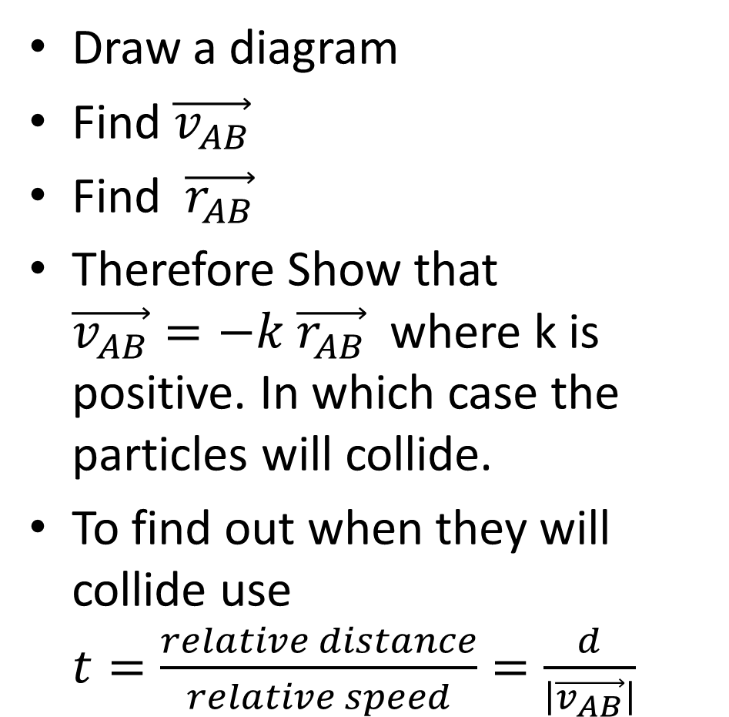
Collision Questions-Investigating if two bodies starting in different places will collide? and when?
Eg. Q10 p51 then Q 11,12
Draw a diagram
Find $\vec{v_{AB}}$
Find $\vec{r_{AB}}$
Therefore Show that $\vec{v_{AB}}=−k$ $\vec{r_{AB}}$ where k is positive. In which case the particles will collide.
To find out when they will collide use $t=\frac{relative distance}{relative speed}=\frac{d}{\left|\vec{v_{AB}}\right|}$
d
Questions 10-12

Slide 8
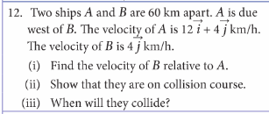
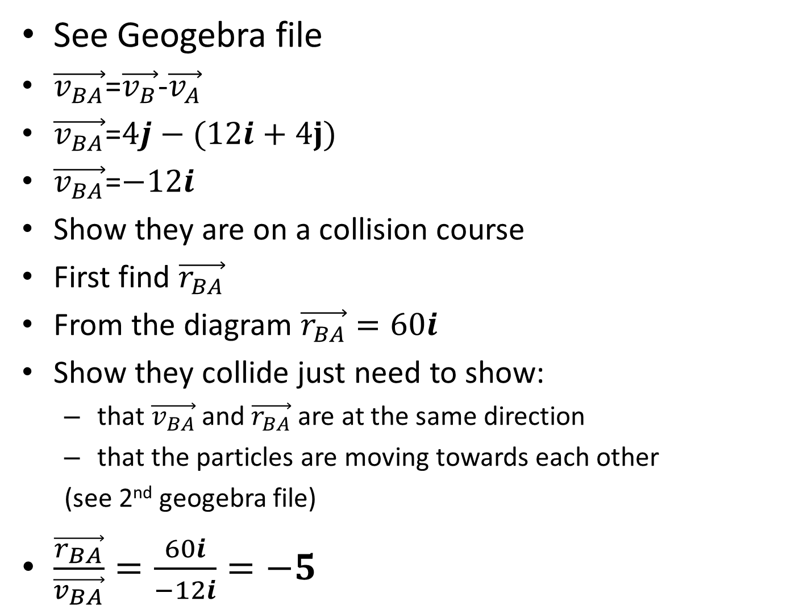
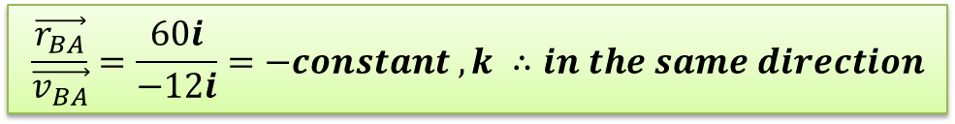
Clarification on proving that particles will collide- Q12 p50
See Geogebra file
$\vec{v_{BA}}$=$\vec{v_{B}}$-$\vec{v_{A}}$
$\vec{v_{BA}}$=$4j−(12i+4j)$
$\vec{v_{BA}}$=$−12i$
Show they are on a collision course
First find $\vec{r_{BA}}$
From the diagram $\vec{r_{BA}}=60i$
Show they collide just need to show:
  that $\vec{v_{BA}}$ and $\vec{r_{BA}}$ are at the same direction
  that the particles are moving towards each other
  (see 2nd geogebra file)
$\frac{\vec{r_{BA}}}{\vec{v_{BA}}}=\frac{60i}{−12i}=−5$
$$\frac{\vec{r_{BA}}}{\vec{v_{BA}}}=\frac{60i}{−12i}=−constant , k ∴in the same direction$$

Slide 9

Collision Questions-Determining the conditions needed for two objects starting east west of each other to collide
P51 q13-16
If they are on a collision course then:
  The j components must be the same
  They must be moving towards each other.
  So make the j components the same and make sure they move towards each other!
Geogebra worksheet online
Q13
$\left|ti+3j\right|=5$
${\left(t^{2}+3^{2}\right)}^{}=5^{2}$
$t^{2}+9=25$
$t^{2}−16=0$
$(t+4)(t−4)=0$
$t=−4$ and $t=4$ since t is greater than 0.
rdh

Slide 10
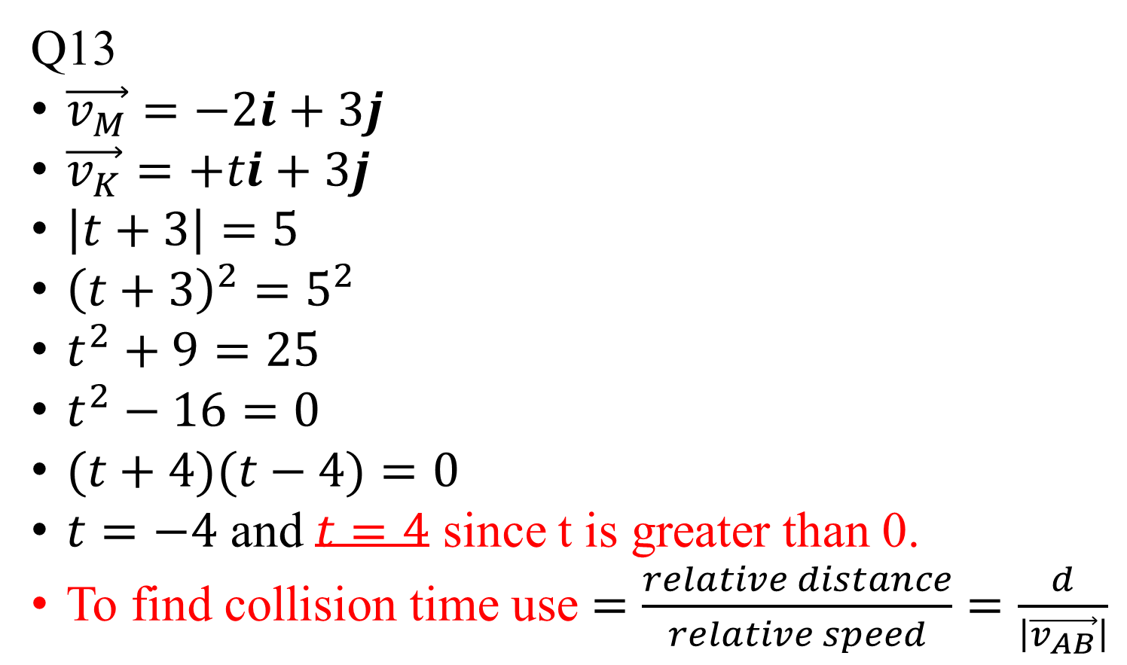
Collision Questions-Determining the conditions needed for two objects starting east west of each other to collide
P51 q13-16
If they are on a collision course then:
  The j components must be the same
  They must be moving towards each other.
  So make the j components the same and make sure they move towards each other!
Geogebra worksheet online
Q13
$\vec{v_{M}}=−2i+3j$
$\vec{v_{K}}=+ti+3j$
$\left|t+3\right|=5$
${\left(t+3\right)}^{2}=5^{2}$
$t^{2}+9=25$
$t^{2}−16=0$
$(t+4)(t−4)=0$
$t=−4$ and $t=4$ since t is greater than 0.
To find collision time use $=\frac{relative distance}{relative speed}=\frac{d}{\left|\vec{v_{AB}}\right|}$

Slide 11
Collision Qs-When particles do not start east-west P51 q17 on
Draw a diagram showing the velocities for question 17 p51
Can you use your diagram to solve the problem?
For East-West problems we saw that they would collide if the j components of their velocities were the same and their relative velocity in the j direction was zero. Can we use this approach here?
For East-West problems how did we show that two object would collide? Can we use this approach here?
No

Slide 12
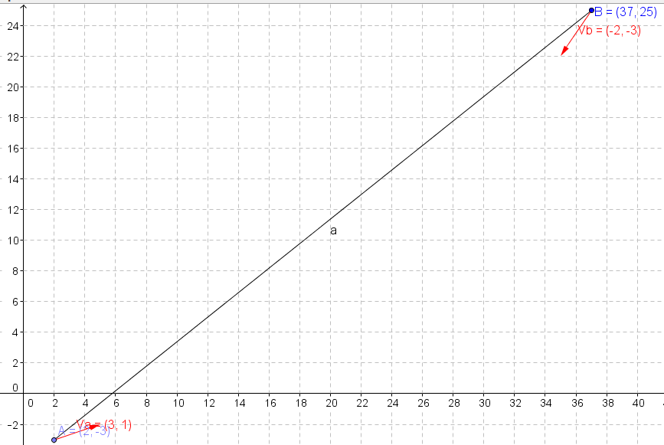





$$\vec{r_{BA}}=\left(37i+25j\right)−\left(3i+1j\right)$$
$$\vec{r_{BA}}=\left(37−2\right)i+\left(25−−3\right)j$$
$$\vec{r_{BA}}=\left(35\right)i+\left(28\right)j$$
$$\vec{v_{BA}}=\left(3i+1j \right)−\left(−2i−3j \right)$$
$$\vec{v_{BA}}=\left(5\right)i+\left(4\right)j$$

Slide 14


Finding a velocity given tow particles are on a collisions course
Eg. Q10 p51 then Q 13,14
Draw a diagram showing the two objects at the initial separation, d, and their velocity vectors.
If it is not already, make the i direction along the line between the two bodies starting positions.
Make use of the fact that if the two bodies to collide they must have the same j components.
d

Slide 15
Finding the point of closest approach
Start with geogebra file from q12 in last exercise. Can we use this diagram?

Slide 16
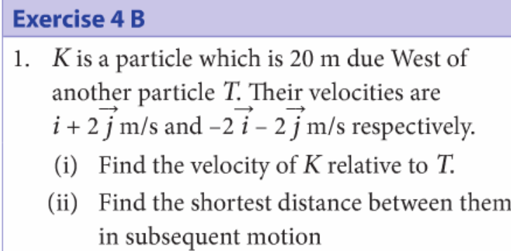
Finding the closest Distance two objects get from each other
Draw a diagram showing the initial positions and velocities of the particles and

Slide 17
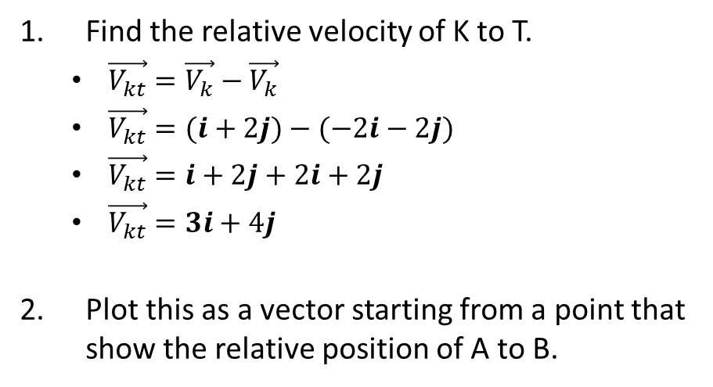
Finding the closest Distance two objects get from each other
Find the relative velocity of K to T.
  $\vec{V_{kt}}=\vec{V_{k}}−\vec{V_{k}}$
  $\vec{V_{kt}}=(i+2j)−(−2i−2j)$
  $\vec{V_{kt}}=i+2j+2i+2j$
  $\vec{V_{kt}}=3i+4j$
Plot this as a vector starting from a point that show the relative position of A to B.

Slide 18
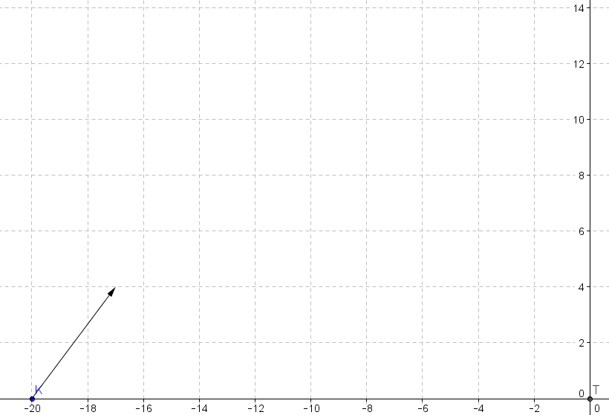

Finding the closest Distance two objects get from each other
  $\vec{V_{kt}}=3i+4j$

Slide 19
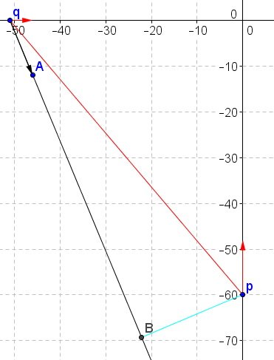
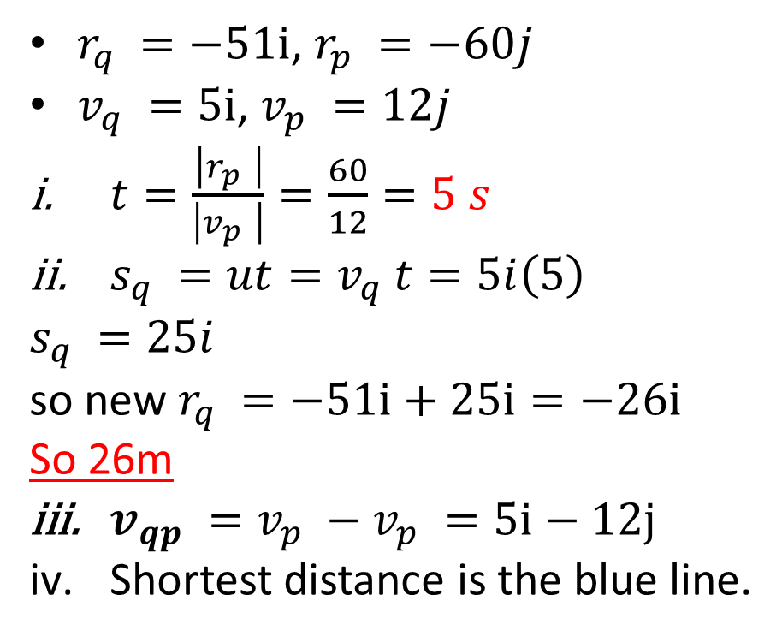
Awkward Angle Questions. Eg. Question 1 Ex 4c
$r_{q }=−51i$, $r_{p }=−60j$
$v_{q }=5i$, $v_{p }=12j$
$t=\frac{\left|r_{p }\right|}{\left|v_{p }\right|}=\frac{60}{12}=5 s$
$s_{q }=ut=v_{q }t=5i\left(5\right)$
$s_{q }=25i$
so new $r_{q }=−51i+25i=−26i$
So 26m
$v_{qp }={v_{p }−v}_{p }=5i−12j$
Shortest distance is the blue line.

Slide 20
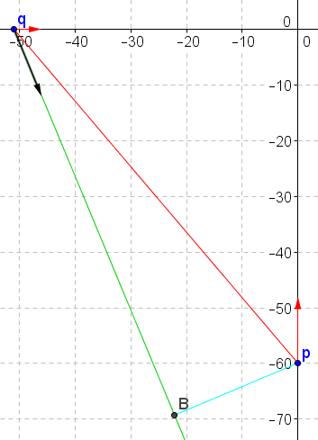
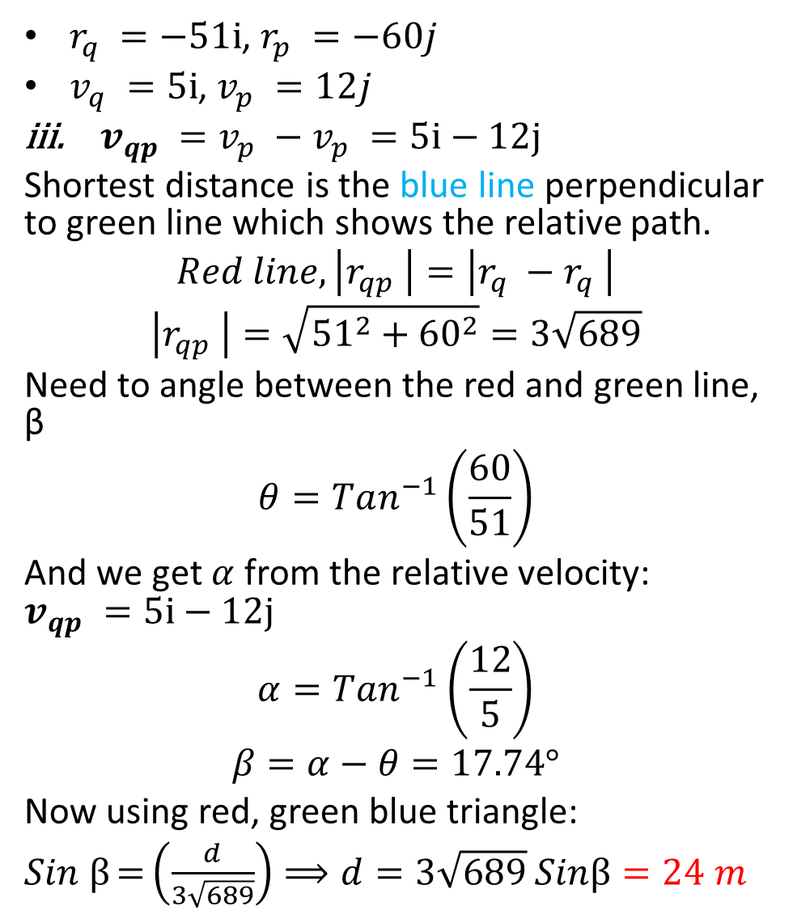
$r_{q }=−51i$, $r_{p }=−60j$
$v_{q }=5i$, $v_{p }=12j$
$v_{qp }={v_{p }−v}_{p }=5i−12j$
Shortest distance is the blue line perpendicular to green line which shows the relative path.
$$Red line, \left|r_{qp }\right|=\left|r_{q }−r_{q }\right|$$
$$\left|r_{qp }\right|=\sqrt{{{51}^{2}+60}^{2}}=3\sqrt{689}$$
Need to angle between the red and green line, β
$$θ=Tan^{−1}\left(\frac{60}{51}\right)$$
And we get $α$ from the relative velocity: $v_{qp }=5i−12j$
$$α=Tan^{−1}\left(\frac{12}{5}\right)$$
$$β=α−θ=17.74°$$
Now using red, green blue triangle:
$Sin β=\left(\frac{d}{3\sqrt{689}}\right)⟹d=3\sqrt{689}$ $Sinβ=24 m$
α
θ
β
d

Slide 21
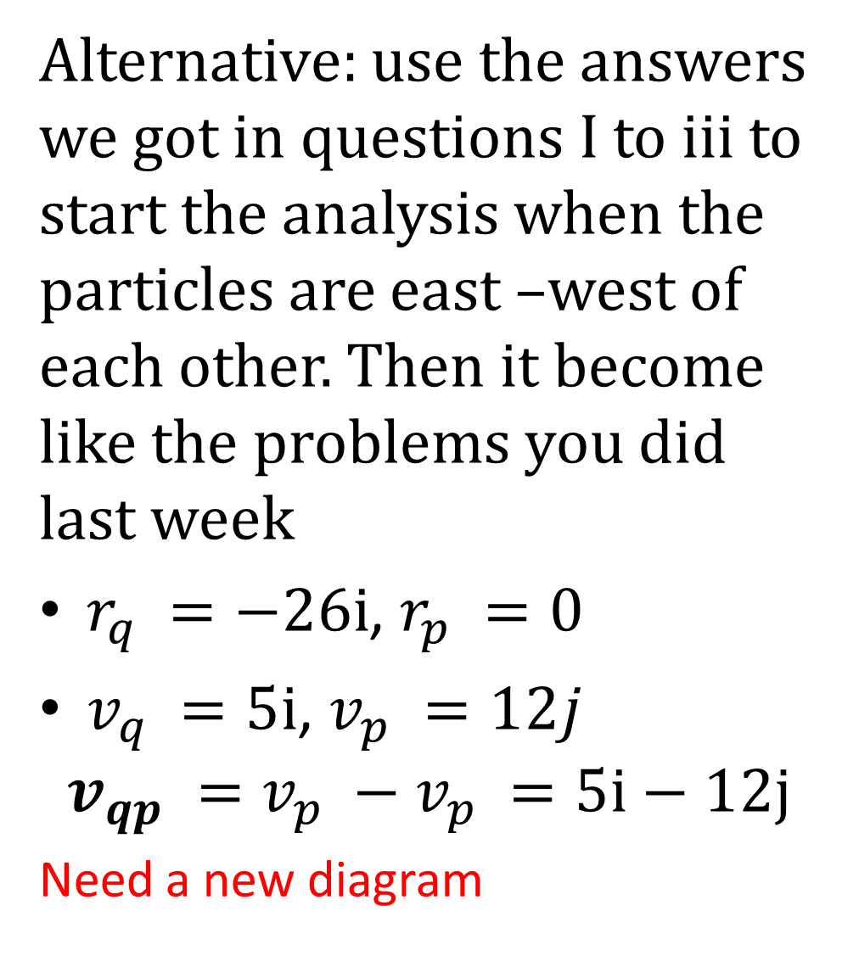
Alternative: use the answers we got in questions I to iii to start the analysis when the particles are east –west of each other. Then it become like the problems you did last week
$r_{q }=−26i$, $r_{p }=0$
$v_{q }=5i$, $v_{p }=12j$
$$v_{qp }={v_{p }−v}_{p }=5i−12j$$
Need a new diagram
α
θ
β
d

Slide 22
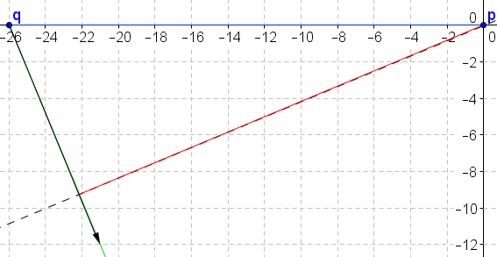
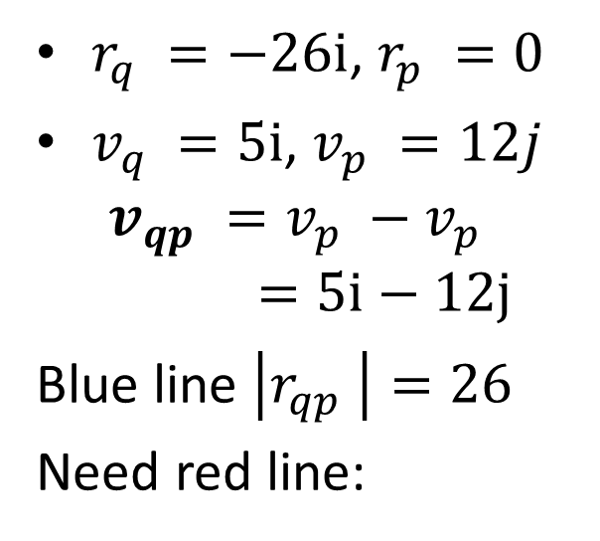
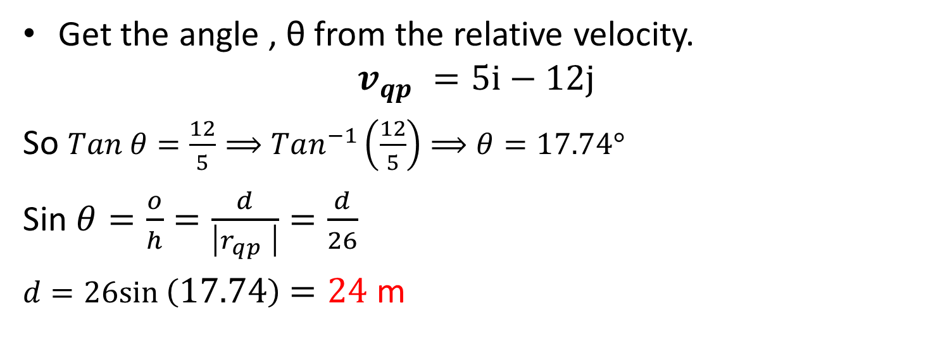
$r_{q }=−26i$, $r_{p }=0$
$v_{q }=5i$, $v_{p }=12j$
$$v_{qp }={v_{p }−v}_{p }=5i−12j$$
Blue line $\left|r_{qp }\right|=26$
Need red line:
Virtual Path
Get the angle , θ from the relative velocity.
$$v_{qp }=5i−12j$$
So $Tan θ=\frac{12}{5}⟹Tan^{−1}\left(\frac{12}{5}\right)⟹θ=17.74°$
Sin $θ=\frac{o}{h}=\frac{d}{\left|r_{qp }\right|}=\frac{d}{26}$
$d=26sin \left(17.74\right)=24$ m

Slide 23
Awkward angle questions
Draw a diagram
Relative velocity
Find the time taken for the particles to be east west(or north-south) of each other and the position of the two particles at this time.
Draw a new diagram
Use the relative velocity to show the realtive path.
Find the angle of the relative path and from that the perpendicular distance as required.

Slide 24
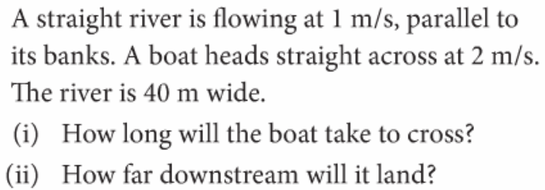

River Questions
$$40 m$$

Slide 25

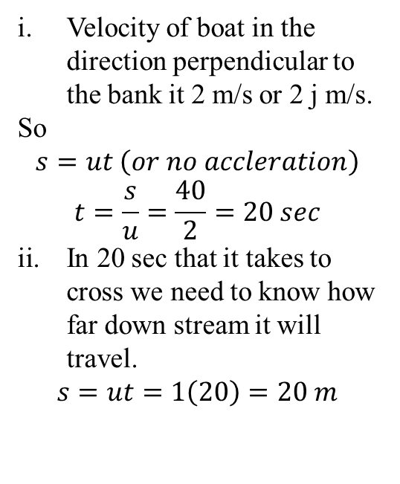



River Questions (Simple Q Q1 and 2 exercise 4d)
Velocity of boat in the direction perpendicular to the bank it 2 m/s or 2 j m/s.
So
$$s=ut \left(or no accleration\right)$$
$$t=\frac{s}{u}=\frac{40}{2}=20 sec$$
In 20 sec that it takes to cross we need to know how far down stream it will travel.
$$s=ut=1\left(20\right)=20 m$$
$$v_{r }=1 i m s^{−1}$$
Velocity of river
$$40 m$$
Velocity of boat relative to the water.
$$v_{br }=2 i m s^{−1}$$
$$v_{b }=?$$
Velocity of boat relative to the bank

Slide 26


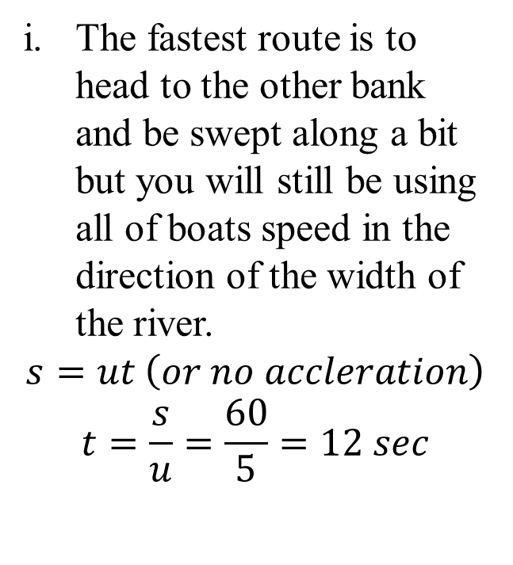


River Questions-Quickest route Q3 p58
A river is 60 m wide..
The river flows at 3 m/s parallel to the banks.
A boat can go at 5m/s in still water.
The fastest route is to head to the other bank and be swept along a bit but you will still be using all of boats speed in the direction of the width of the river.
$$s=ut \left(or no accleration\right)$$
$$t=\frac{s}{u}=\frac{60}{5}=12 sec$$
$$v_{r }=3 i m s^{−1}$$
Velocity of river
$$60 m$$
Velocity of boat .
$$v_{br }=5 i m s^{−1}$$
$$v_{b }=?$$
Velocity of boat relative to the bank

Slide 27


River Questions-The shortest route Q3 p58
A river is 60 m wide..
The river flows at 3 m/s parallel to the banks.
A boat can go at 5m/s in still water.
ii. The shortest route is the path perpendicular to the banks.
This involves the boat pointing a bit upstream and allowing the current to move it back upstream as it crosses such that he reaches the other side directly opposite to where it started.
The component of the boat’s velocity parallel to the bank should be equal and opposite to the velocity of the river.
$$v_{r }=3 i m s^{−1}$$
Velocity of river
Velocity of boat relative to the still water.
$$60 m$$
$$v_{b\text{B} }=?$$
Velocity of boat relative to the bank
$$v_{b }=x i+y j m s^{−1}$$

Slide 28
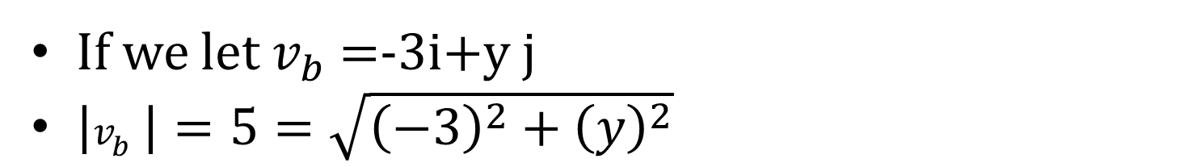
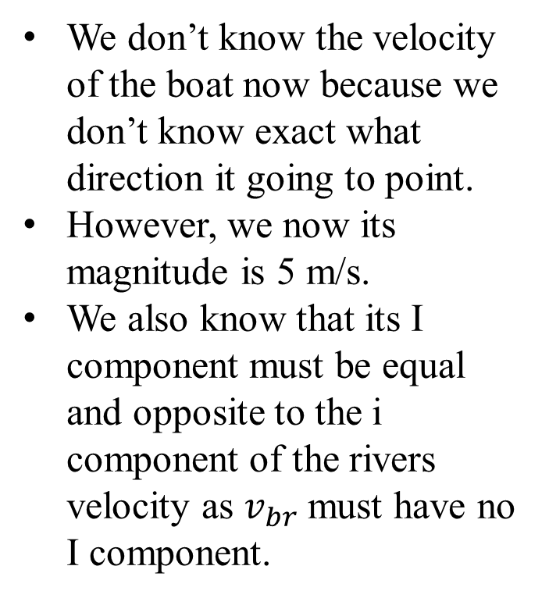

River Questions-The shortest route Q3 p58
A river is 60 m wide..
The river flows at 3 m/s parallel to the banks.
A boat can go at 5m/s in still water.
We don’t know the velocity of the boat now because we don’t know exact what direction it going to point.
However, we now its magnitude is 5 m/s.
We also know that its I component must be equal and opposite to the i component of the rivers velocity as $v_{br }$must have no I component.
$$v_{r }=3 i m s^{−1}$$
Velocity of river
Velocity of boat relative to the still water.
$$60 m$$
$$v_{bB }=?$$
Velocity of boat relative to the bank
$$v_{b }=x i+y j m s^{−1}$$
If we let $v_{b }$=-3i+y j
$\left|v_{b }\right|=5=\sqrt{{\left(−3\right)}^{2}+{\left(y\right)}^{2}}$

Slide 29
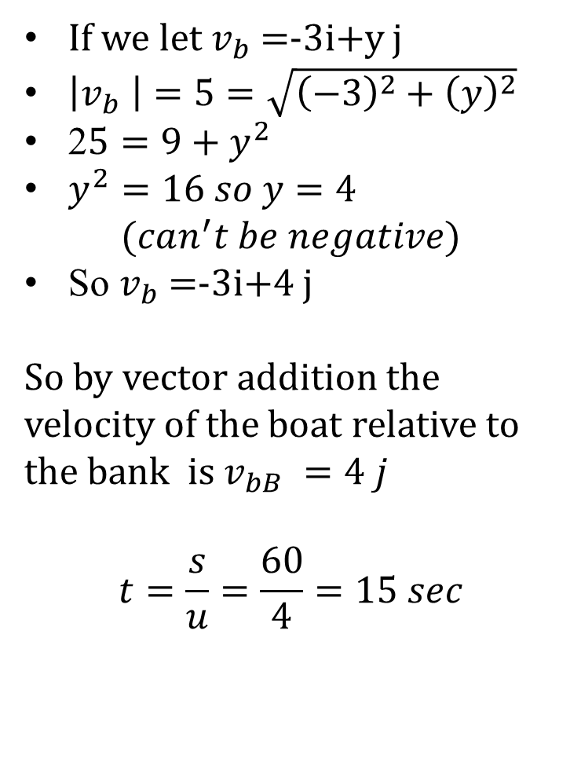
River Questions-The shortest route Q3 p58
If we let $v_{b }$=-3i+y j
$\left|v_{b }\right|=5=\sqrt{{\left(−3\right)}^{2}+{\left(y\right)}^{2}}$
2$5=9+y^{2}$
$y^{2}=16 so y=4$
$$(can^{′}t be negative)$$
So $v_{b }$=-3i+4 j
So by vector addition the velocity of the boat relative to the bank is $v_{bB }=4 j$
$$t=\frac{s}{u}=\frac{60}{4}=15 sec$$
A river is 60 m wide..
The river flows at 3 m/s parallel to the banks.
A boat can go at 5m/s in still water.
$$v_{r }=3 i m s^{−1}$$
Velocity of river
Velocity of boat relative to still water.
$$60 m$$
$$v_{bB }=?$$
Velocity of boat relative to the bank
$$v_{b }=x i+y j m s^{−1}$$

Slide 30
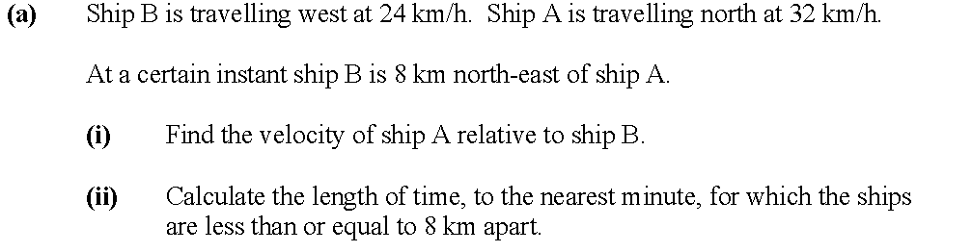

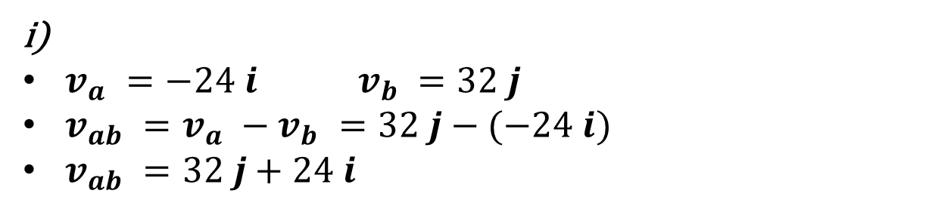




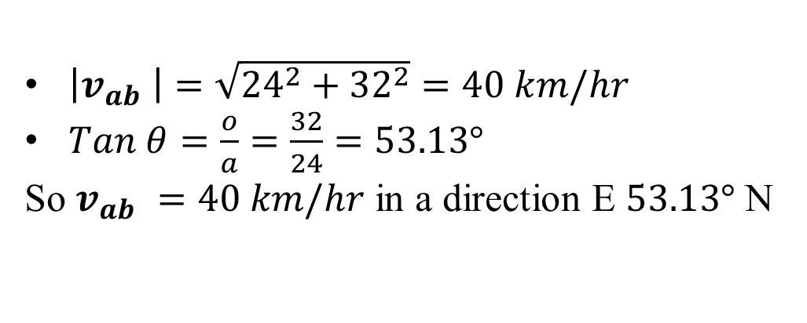


2007partA
$$−24 i$$
$$b$$
$$32 j$$
$v_{a }=−24 i v_{b }=32 j$
$v_{ab }=v_{a }−v_{b }=32 j−(−24 i)$
$v_{ab }=32 j+24 i$
8 km
$$a$$
$\left|v_{ab }\right|=\sqrt{{24}^{2}+{32}^{2}}=40 km/hr$
$Tan θ=\frac{o}{a}=\frac{32}{24}=53.13°$
So $v_{ab }=40 km/hr$ in a direction E $53.13°$ N
$$32 j$$
$$θ$$
$$24 i$$

Slide 31
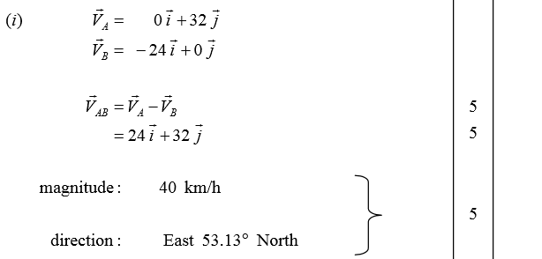
Actual Mark scheme- Note: needed to find magnitude and direction

Slide 32

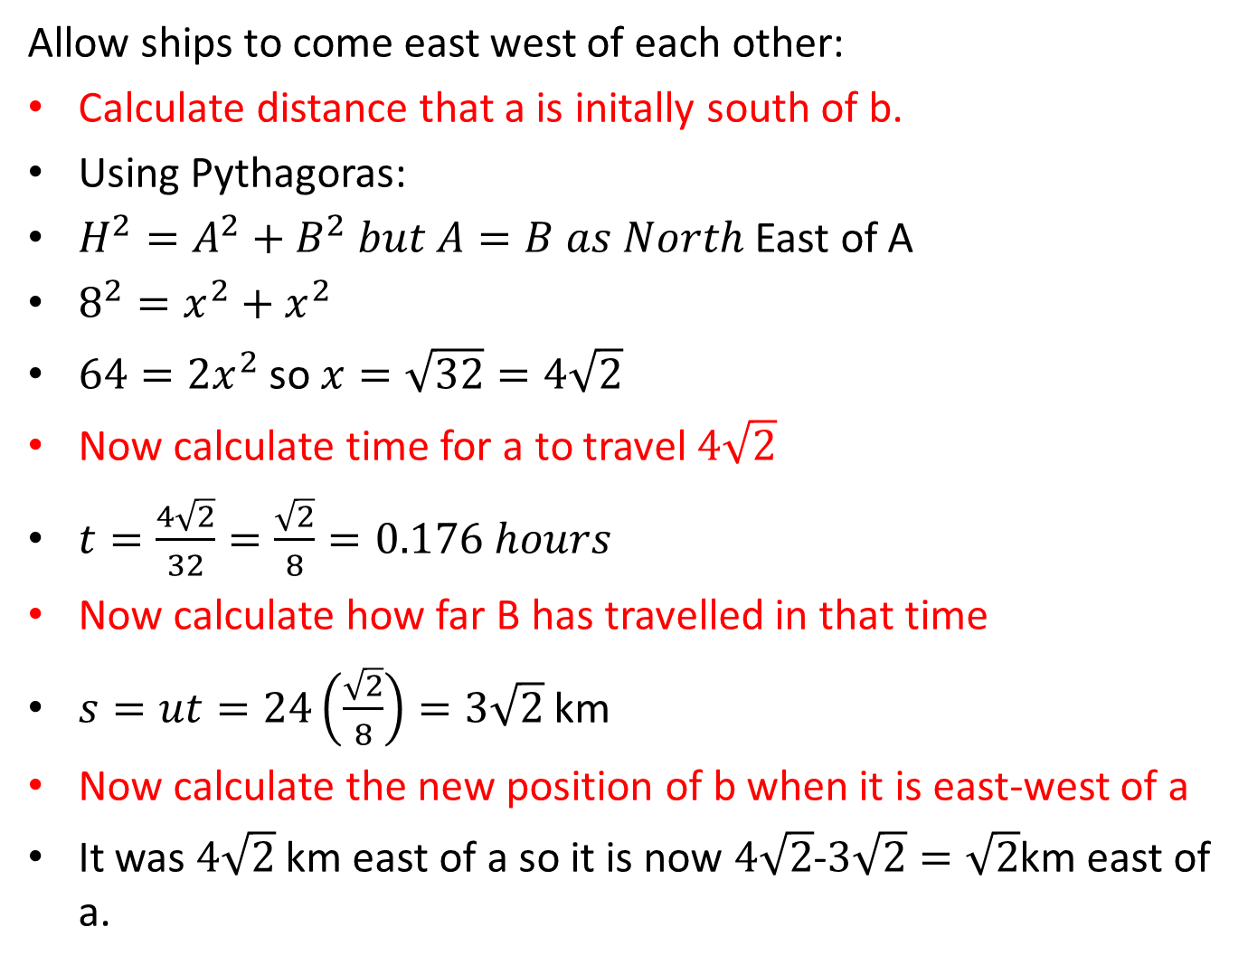



Allow ships to come east west of each other:
Calculate distance that a is initally south of b.
Using Pythagoras:
$H^{2}=A^{2}+B^{2} but A=B as North$ East of A
$8^{2}=x^{2}+x^{2}$
$64={2x}^{2}$ so $x=\sqrt{32}=4\sqrt{2}$
Now calculate time for a to travel $4\sqrt{2}$
$t=\frac{4\sqrt{2}}{32}=\frac{\sqrt{2}}{8}=0.176 hours$
Now calculate how far B has travelled in that time
$s=ut=24\left(\frac{\sqrt{2}}{8}\right)=3\sqrt{2}$ km
Now calculate the new position of b when it is east-west of a
It was $4\sqrt{2}$ km east of a so it is now $4\sqrt{2}$-$3\sqrt{2}=\sqrt{2}$km east of a.
$$x$$
$$b$$
$$x$$
8 km
$$a$$

Slide 33


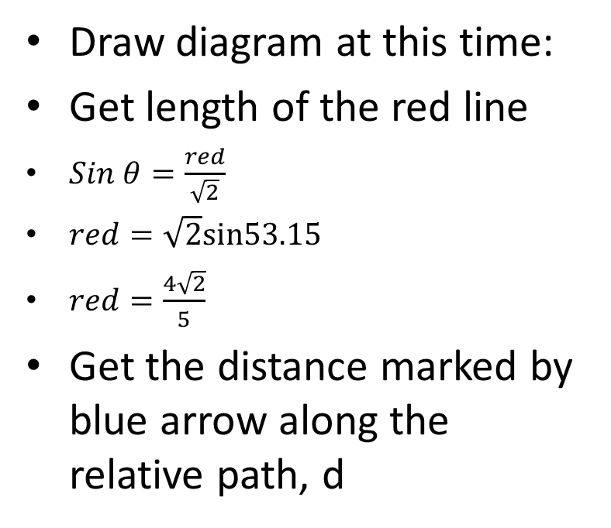



Draw diagram at this time:
Get length of the red line
$Sin θ=\frac{red}{\sqrt{2}}$
$red=\sqrt{2}sin53.15$
$red=\frac{4\sqrt{2}}{5}$
Get the distance marked by blue arrow along the relative path, d
What is the problem????
A and B already less that 8km from each other.
$d$
8 km ?
$32$j
8 km?
$$θ$$
A
B
$$24 i$$
$\sqrt{2}$ (from previous slide)
Get the time taken to travel along the relative path
distance marked by blue arrow along the relative path, d

Slide 34



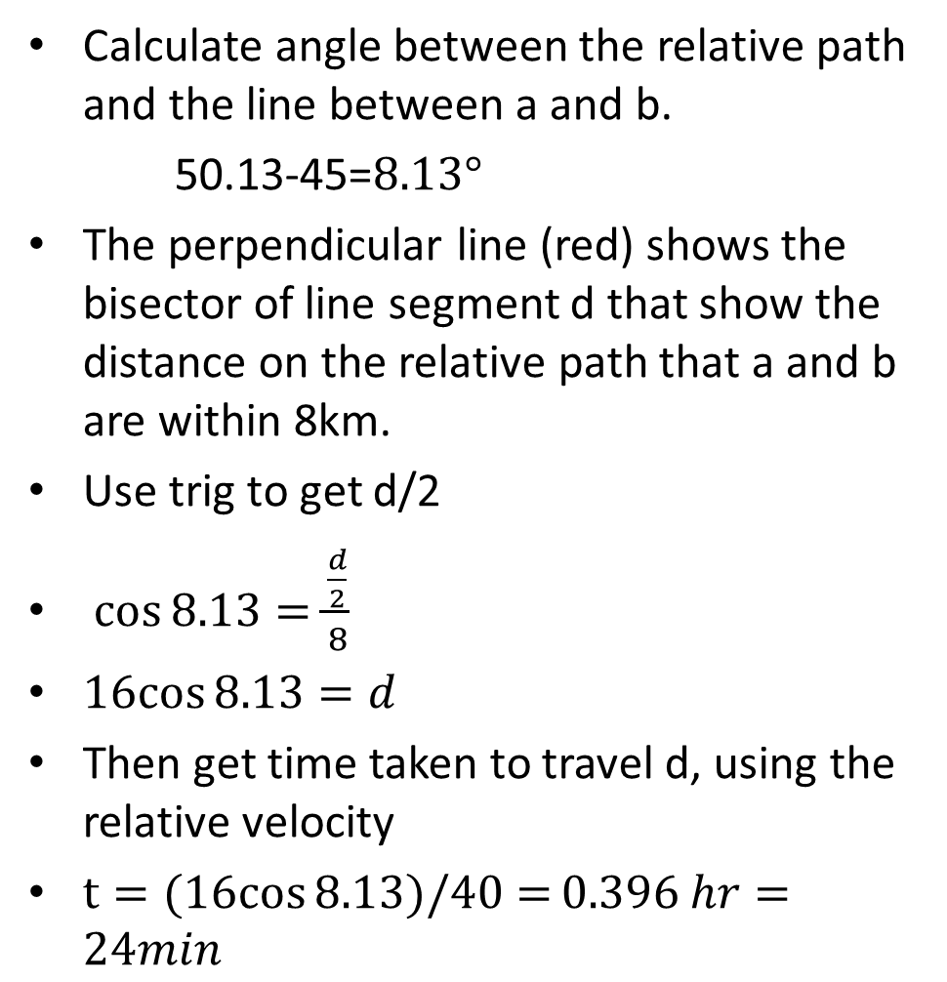




Alternative approach
Calculate angle between the relative path and the line between a and b.
50.13-45=$8.13°$
The perpendicular line (red) shows the bisector of line segment d that show the distance on the relative path that a and b are within 8km.
Use trig to get d/2
$\cos{8.13=\frac{\frac{d}{2}}{8}}$
$16cos{8.13=d}$
Then get time taken to travel d, using the relative velocity
$t=(16cos{8.13)/40=}0.396 hr=24min$
8 km
$$Relative path$$
$$\frac{d}{2}$$
$$b$$
$v_{ab}$=40 km
$$8.13°$$
8 km
$$45°$$
$$a$$

Slide 35
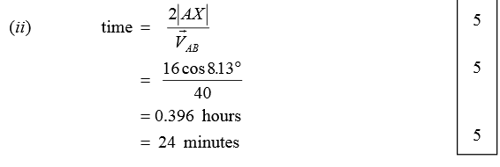

Slide 36
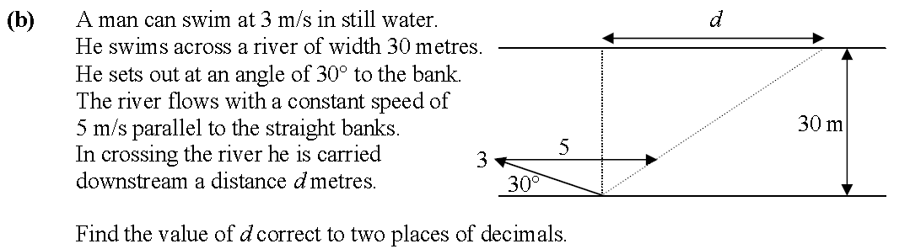
2007 Q2 part b

Slide 37
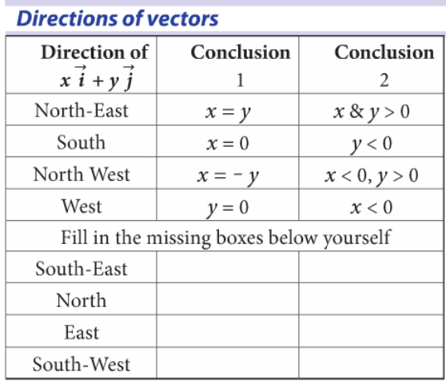
Winds and Apparent Winds

Slide 38
Winds and Apparent Winds

Slide 39
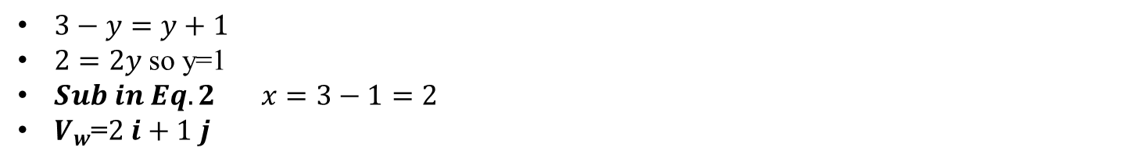
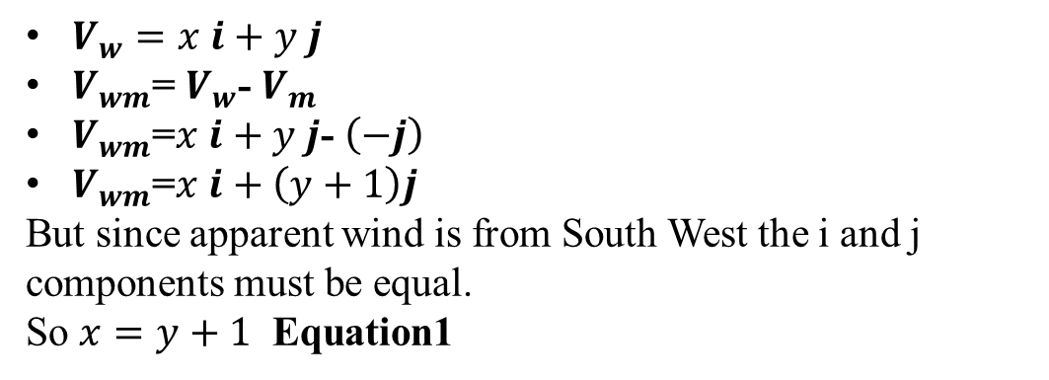



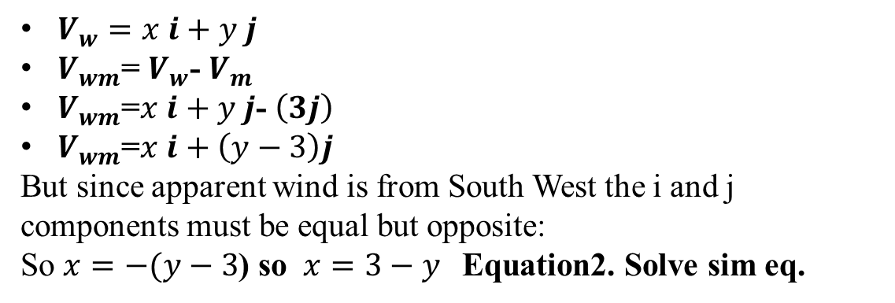

Winds and Apparent Winds Q2 Ex4E
$V_{w}=x i+y j$
$V_{wm}$= $V_{w}$- $V_{m}$
$V_{wm}$=$x i+y j$- $\left(−j\right)$
$V_{wm}$=$x i+\left(y+1\right)j$
But since apparent wind is from South West the i and j components must be equal.
So $x=y+1$ Equation1
$$V_{m}=−j$$
$$V_{wm}$$
$V_{w}=x i+y j$
$V_{wm}$= $V_{w}$- $V_{m}$
$V_{wm}$=$x i+y j$- $\left(3j\right)$
$V_{wm}$=$x i+\left(y−3\right)j$
But since apparent wind is from South West the i and j components must be equal but opposite:
So $x=−(y−3$) so $x=3−y$Equation2. Solve sim eq.
$$V_{wm}$$
$$V_{m}=3 j$$
$3−y=y+1$
$2=2y$ so y=1
$Sub in Eq.2 x=3−1=2$
$V_{w}$=$2 i+1 j$

Slide 40
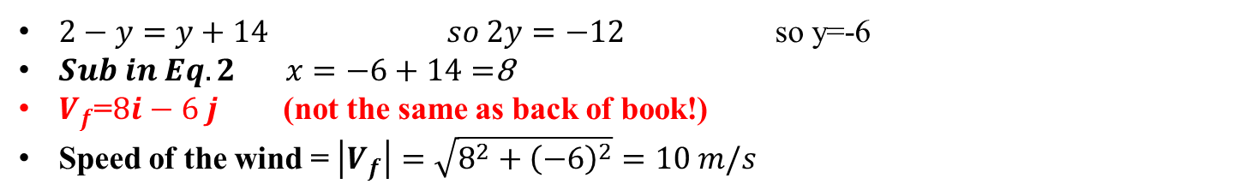
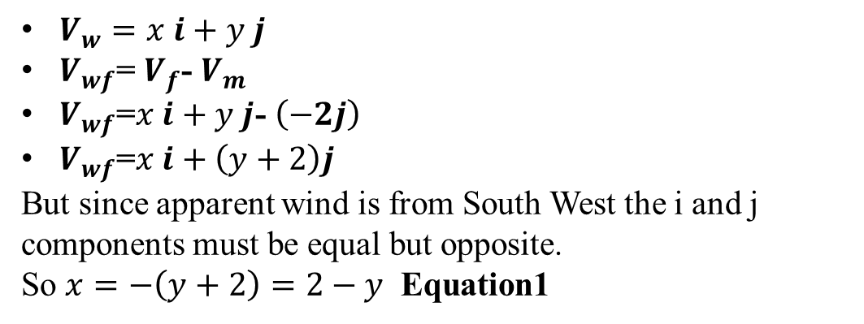



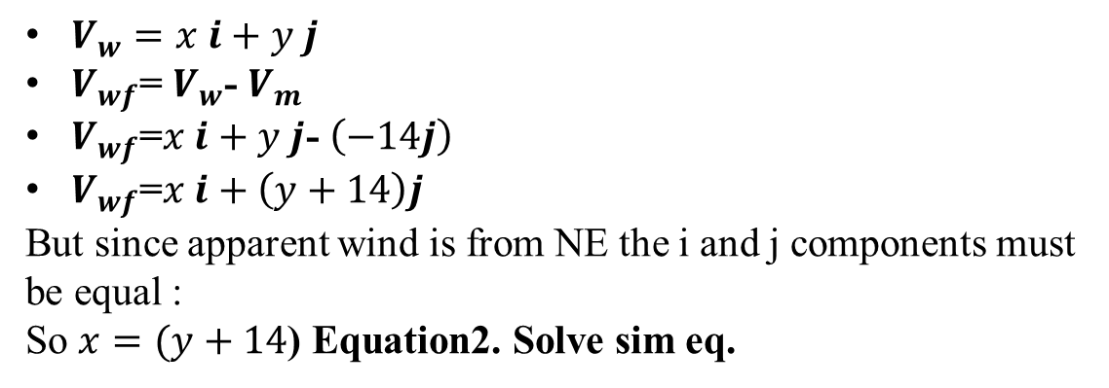

Winds and Apparent Winds Q2 Ex4E
$V_{w}=x i+y j$
$V_{wf}$= $V_{f}$- $V_{m}$
$V_{wf}$=$x i+y j$- $\left(−2j\right)$
$V_{wf}$=$x i+\left(y+2\right)j$
But since apparent wind is from South West the i and j components must be equal but opposite.
So $x=−\left(y+2\right)=2−y$ Equation1
$$V_{f}=−2j$$
$$V_{wf}$$
$V_{w}=x i+y j$
$V_{wf}$= $V_{w}$- $V_{m}$
$V_{wf}$=$x i+y j$- $\left(−14j\right)$
$V_{wf}$=$x i+\left(y+14\right)j$
But since apparent wind is from NE the i and j components must be equal :
So $x=(y+14$) Equation2. Solve sim eq.
$$V_{wf}$$
$$V_{f}=−14 j$$
$2−y=y+14 so 2y=−12$so y=-6
$Sub in Eq.2 x=−6+14=$8
$V_{f}$=$8i−6 j$ (not the same as back of book!)
Speed of the wind = $\left|V_{f}\right|=\sqrt{8^{2}+{\left(−6\right)}^{2}}=10 m/s$

Slide 41
Exam Questions-Four Types of Question
Problems Involving Two Particles
When are they closest together
Road Junctions
Rivers, Currents and Winds
When are they within a certain range of each other
Apparent Velocity of the Wind

Slide 42
2009 – Q2 – Ordinary Level

Slide 43
Solution

Slide 44
Exercise – 2006 – Q2 – O.L.

Slide 45
Solution

Slide 46
2004 – Q2(b) – Higher Level

Slide 47
Solution

Slide 48
Exercise – 1996 – Q2 – H.L.

Slide 49
Solution

Slide 50
2007 – Q2(a) – Higher Level

Slide 51
Solution

Slide 52
Exercise – 2002 – Q2(a) – H.L.

Slide 53
Solution

Slide 54
2009 – Q2(a) – Higher Level

Slide 55
Solution

Slide 56
Exercise – 2008 – Q2(a) – H.L.

Slide 57
Solution

Slide 58
2009 – Q2(b) – Higher Level

Slide 59
Solution

Slide 60
Exercise – 2006 – Q2(a) – H.L.

Slide 61
Solution

Slide 62
2008 – Q2(b) – Higher Level

Slide 63
Solution

Slide 64
Exercise – 2010 – Q2(b) – H.L.

Slide 65
Solution

