Slide 1
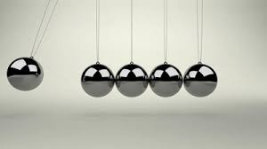
The Conservation of Energy and momentum

Slide 2
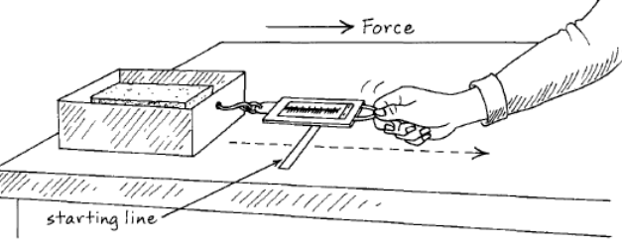
Work
How do we calculate work?
$W=F.s$
Note: F is the Force in the direction of Movement
What are the units for work?
Joules, J

Slide 3
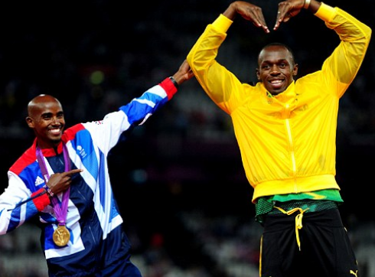
Power
Which is more powerful Usain Bolt or Mo Farah?
Why?
How do we calculate Power?
$P=\frac{W}{t}$
What are the units for Power?
Watts, W

Slide 4
Exercise 6A
Q 1 (3 minutes)

Slide 5
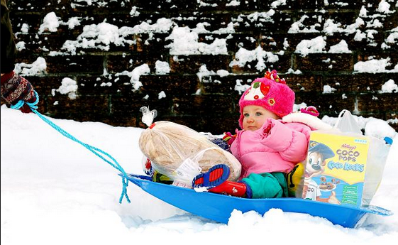
Question3
$\tan{A=\frac{5}{12}}$
We need to know what the magnitude of the component of the Force in the direction of the displacement.
A
h=13
o=5
A
S=50m
a=12
$\cos{A=\frac{F_{x}}{130}}$
$F_{x}=130 cos{A=130\left(\frac{12}{13}\right)}$
$F_{x}=120$N
$W=Fs=WF_{x}$
$W=Fs=120$(50)=6000 J
$$Power=\frac{W}{t}=\frac{6000}{60}=100 W$$
Question 6
h=130 N
A
a=$F_{x}$

Slide 6
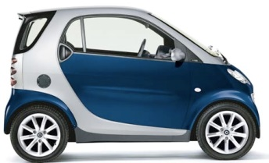
Tractive Force
$$F$$
$$u=v$$
Imagine a car drive by a constant force travelling at a constant velocity.
$P=\frac{W}{t}\text{,} s=ut$, $W=F.s$
Combine these equations to derive an equation for P in terms of F and v
$P=Fv$. We call the Force driving the motion the Tractive Effort, $T$.
$P=Tv$.

Slide 7
Q7 and Then Hwk/cwk 8,9,10, 11,13

Slide 8
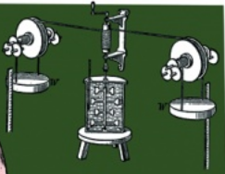
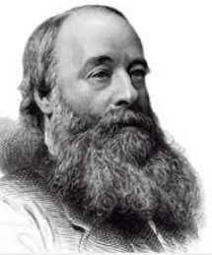
Energy
What is the definition of energy?
The ability to do work?
Energy comes in different forms, how many can you name?
Heat, light (E-M radiation), electricity, chemical, Elastic Potential, Gravitational Potential, Kinetic
What is the principle of conservation of energy?
Energy can neither be created or destroyed, only converted from one form to another.

Slide 9
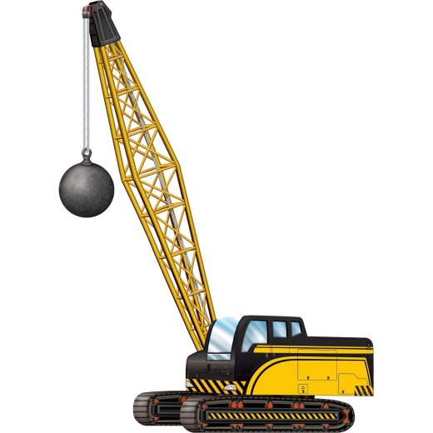
Gravitational Potential Energy, E_{p}
What is Gradational Potential energy?
The energy an object possesses due to its position in a gravitational field
What does it depend on?
Mass, Height and g(the gravitational field strength)
What is the equation for potential energy?
$E_{p}=mgh$

Slide 10
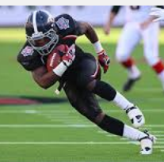
Gravitational Potential Energy, E_{k}
What is kinetic energy?
The energy an object possesses due to it’s motion
What does it depend on?
Mass, speed
What is the equation for kinetic energy?
$E_{k}=\frac{1}{2}mv^{2}$

Slide 11
Applying the principle of Conservation of energy
Total Energy is unchanged
$Total Energy =E_{p}$
$Total Energy =E_{p}+E_{k}$
$Total Energy =E_{k}$

Slide 12
Exercise 6B

Slide 13
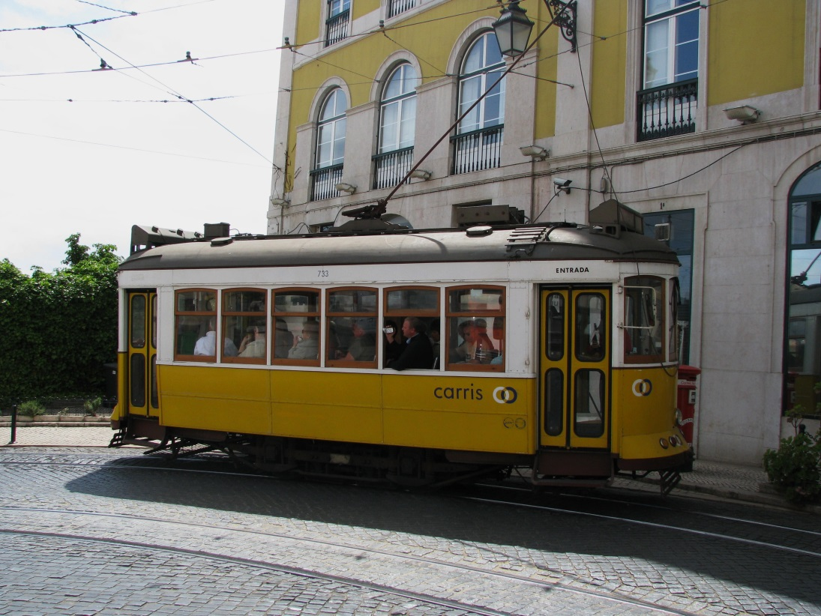
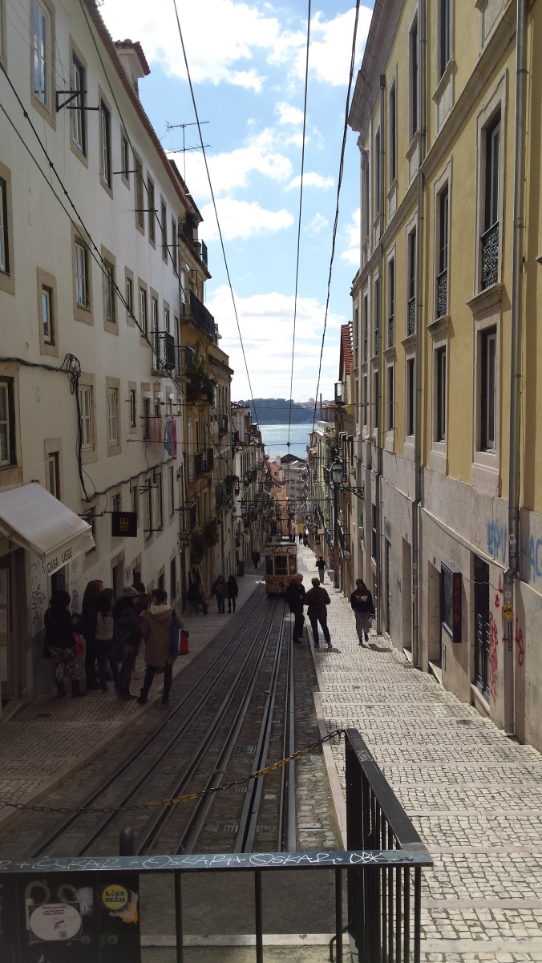
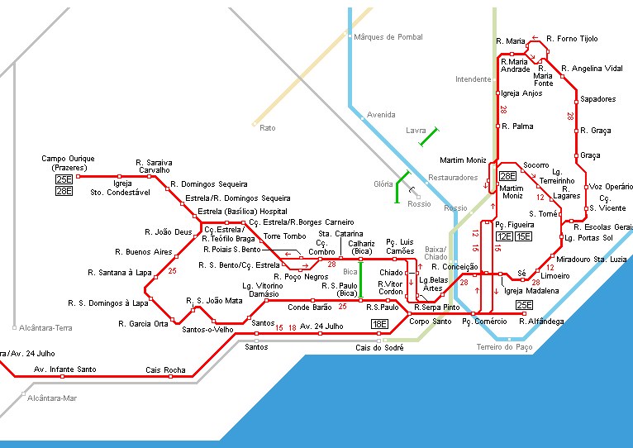
Lisbon’s trams Which tramline uses most power?

Slide 14
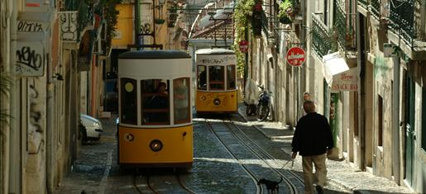
Green Line- Average Gradient of 18%

Slide 15
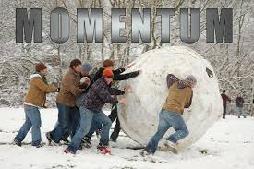
Momentum
What is the definition of momentum?
The product of mass and velocity
So what is the equation for Momentum?
$P=mv$
What are the units of momentum?
$kg m s^{−1}$
We can also use $Ns$ ( you will see this is true on the next slide)

Slide 16
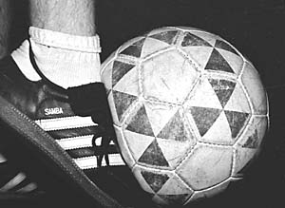
Impulse
From Newton’s ______ law we know that: $F=\frac{∆P}{t}=\frac{mv−mu}{t}$
This is very useful but we cannot tell directly what the change in momentum will be from knowing the size of the force because it also depends up the duration of time for which the force acts.
For example: Imagine a football is struck with an average force of 30 N. The change in the momentum of the ball will vary greatly depending up how long the force(provided by contact with the boot) acts on the ball.
What does the change in momentum depend on?
The product of Force and time: $Ft=∆P=mv−mu$
We define the produce of the Force and the time on which the force acts as Impulse:
$I=Ft and it we have shown that I=∆P=mv−mu$
What are the units for Impulse, $I$? and is it a vector or scalar?
$Ns$, vector $\vec{I}=\vec{F}t$
3rd
Questions 1 to 5 p105

Slide 17
Imagine two balls colliding: show the forces acting on the balls if they collide head on(ignore gravity)
$$V_{1}$$
$$V_{2}$$
$${\begin{aligned} \\ m\end{aligned}}_{1}$$
$$m_{2}$$
$$F_{21}$$
$$F_{12}$$
What do you know about $F_{21}$ and $F_{12}$? Why?
$F_{21}$ = $−F_{12}$, From Newton’s 3rd Law
Write equations for the Impulse acting on mass 1 and mass 2?
$I_{1}=$ $F_{21}t$ and $I_{2}=$ $F_{12}t$, now $F_{21}$ = $−F_{12}$ and t=t so:
$I_{1}=−I_{2}$, (eq.1)
$I_{1}=m_{1}v_{1}−m_{1}u_{1}$ (eq.2) and $I_{2}=m_{2}v_{2}−m_{2}u_{2}$ (eq.3)
So $I_{1}=m_{2}u_{2}−m_{2}v_{2}$ (eq.4) by combining eq.1 and eq.3
Equating the left hand sides of eq2 and eq4:
$m_{2}u_{2}−m_{2}v_{2}$=$m_{1}v_{1}−m_{1}u_{1}$
Rearranging: $m_{2}u_{2}−m_{1}u_{1}$=$m_{1}v_{1}+m_{2}v_{2}$
Momentum before interaction =Momentum after interaction
i.e. Momentum is conserved

Slide 18
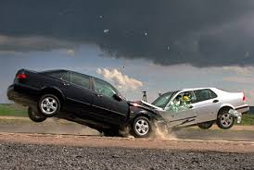
$m_{2}u_{2}−m_{1}u_{1}$=$m_{1}v_{1}+m_{2}v_{2}$
$P_{Initial}$=$P_{Final}$
Momentum is conserved.
Energy is conserved.
Kinetic Energy is not always conserved. During the interaction between the objects, kinetic energy could be turned into other forms.
So: Momentum before= Momentum after
Using these Principles answer Question 6 onwards p105

Slide 19
Exercise 6d: Combining what we know about Momentum and connected particles(pulleys)
$\sum{F}=ma$
$5g−T=5a$ (eq1)
$T−g=a$ (eq2)
$4g=6a$ (eq1+eq2)
$a=\frac{4g}{6}$
After 1 sec, started from rest so u=0:
$s=ut+\frac{1}{2}at^{2}$
$s=\frac{1}{2}\left(\frac{4g}{6}\right){(1)}^{2}=\frac{g}{3}$ m
1.
$$T$$
$$T$$
5
$$a$$
1
$$a$$
$$5g$$
$$g$$

Slide 20
Exercise 6d: Part B: We need to redo our equations of motion but first of all we need to apply the conservation of momentum as the system will slow down once the additional mass it added.
1.
Need v after 1 second for the original system:
$v=u+at=0+\frac{4g}{6}\left(1\right)=\frac{2g}{3}$
$P_{Initial}=P_{final}$
${m_{initial}v}_{Initial}={{mf}_{inal}v}_{final}$
$\left(6\right)\frac{2g}{3}=\left(8\right)v$
$v=\frac{g}{4}$
This is the initial velocity of our new system:
$$T$$
$$T$$
5
$$a$$
1
2
$$a$$
$$5g$$
$$3g$$

Slide 21
Exercise 6d: Combining what we know about Momentum and connected particles(pulleys)
$\sum{F}=ma$
$5g−T=5a$ (eq1)
$T−3g=3a$ (eq2)
$2g=8a$ (eq1+eq2)
$a=\frac{g}{4}$
After 2 sec, so a further second, t=1 started from rest so $u=\frac{g}{4}$:
$s=ut+\frac{1}{2}at^{2}$
$s=\frac{g}{4}\left(1\right)+\frac{1}{2}\left(\frac{g}{4}\right){(1)}^{2}=\frac{5g}{8}$ m
1.
$$T$$
$$T$$
5
$$a$$
1
2
$$a$$
$$5g$$
$$3g$$

